Slide 1

Interactive Maps: Bike Routing Application
CS4900/CS4910 - Soft Sys Dev: Presentation
Team Members:
Bhargav Nandan Gali, Praveen Kumar Devaraj, Brandon D Bergevin

Slide 2
Project Overview
Goal: To Develop an innovative bike routing application tailored for Kalamazoo and Portage, Michigan.
Purpose: Revolutionize the way people experience bicycling by delivering a user-friendly application that offers safe, efficient, and convenient biking routes.
To provide an accessible platform for cyclists.
To promote active transportation.
To ensure a seamless and stress-free biking experience.

Slide 3
Technical Objectives
Utilize Map Box API: Implement Map Box API to calculate biking routes based on factors like traffic density, road width, bike lanes, and speed limits.
User-Friendly Interface: Create a user-friendly interface with radio buttons, allowing cyclists to select road topologies (e.g., Neighborhood Street, Priority/Main) for personalized routes.
GPS Tracking: Integrate GPS location tracking capabilities through Map Box API for real-time user location updates.
Amenity Toggle: Include an amenity toggle feature to display nearby amenities (e.g., restaurants, bike repair shops) on the map for enhanced route planning.
Cross-Platform Compatibility: Make the application compatible with the latest Android and iOS versions to reach a wide user base.

Slide 4
Technical Details: Architecture
The application's technical backbone relies on MapBox API for precise route calculations and map rendering.
Flutter, a versatile framework, is used to create a user-friendly interface compatible with both Android and iOS.
GraphHooper's routing engine allows for seamless turn-by-turn navigation.
This combination of MapBox, Flutter, and GraphHooper ensures a robust and user-centric biking route application.

Slide 5
Technical Details: User Interface Design
The user interface design is centered around simplicity and user-friendliness. With a focus on both Android and iOS platforms, the interface ensures a seamless experience for cyclists.
Interactive menus with radio buttons allow users to select road topologies and toggle amenities based on their preferences. This design empowers cyclists to personalize their routes according to comfort levels and biking preferences.
A GPS icon, powered by MapBox, fetches the user's GPS location, enhancing the overall navigation experience.
Real-time updates on route progress, including turn-by-turn navigation, are displayed, ensuring users have access to accurate timing information during their journey.

Slide 6
Technical Details: Database Structure
The database structure includes the utilization of geojson data for storing and displaying amenity information specific to Kalamazoo and Portage, MI. This data enhances the route planning experience by providing information on essential services along the way.
User preferences for stress levels are collected through the topology toggle menu and compare against street data in the database. These preferences play a crucial role in customizing route recommendations and map displays.
Flutter integrates with MySQL for data access via plugins, allowing seamless data retrieval and updates within the app.

Slide 7
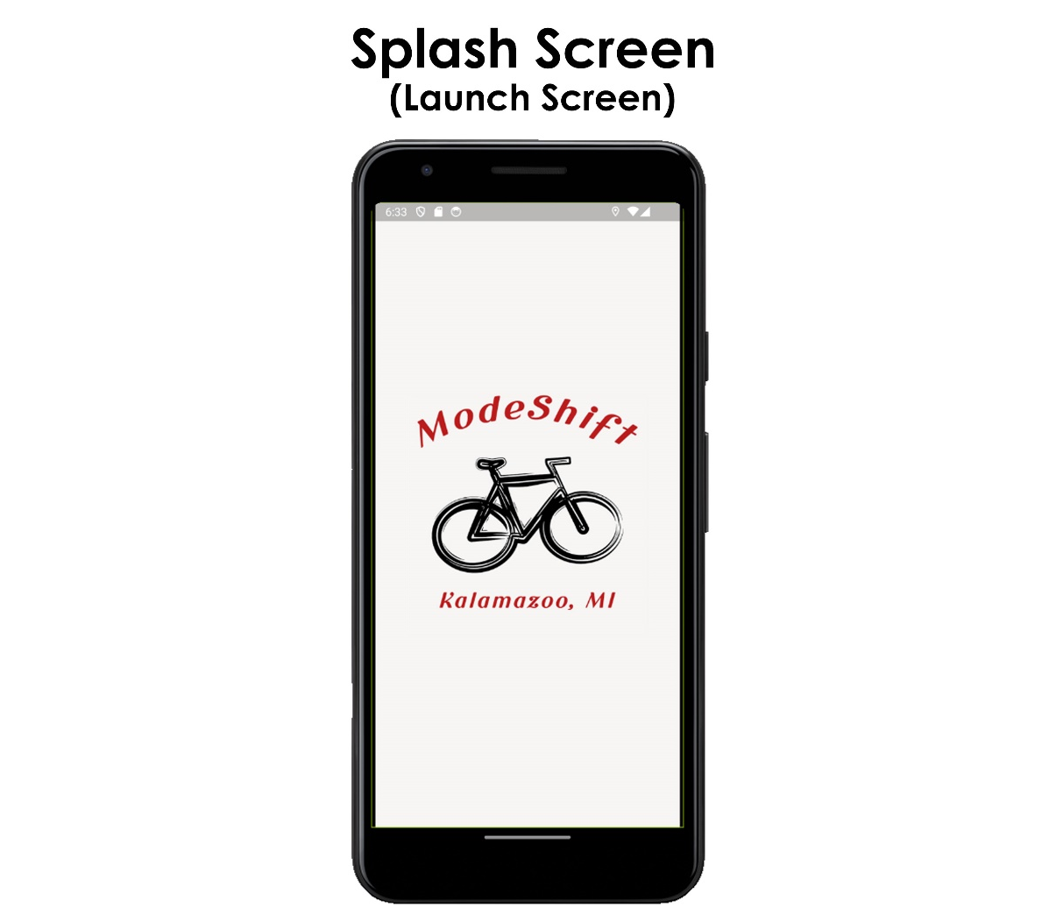
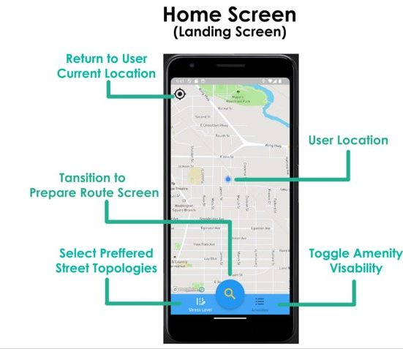
Application Screenshots

Slide 8
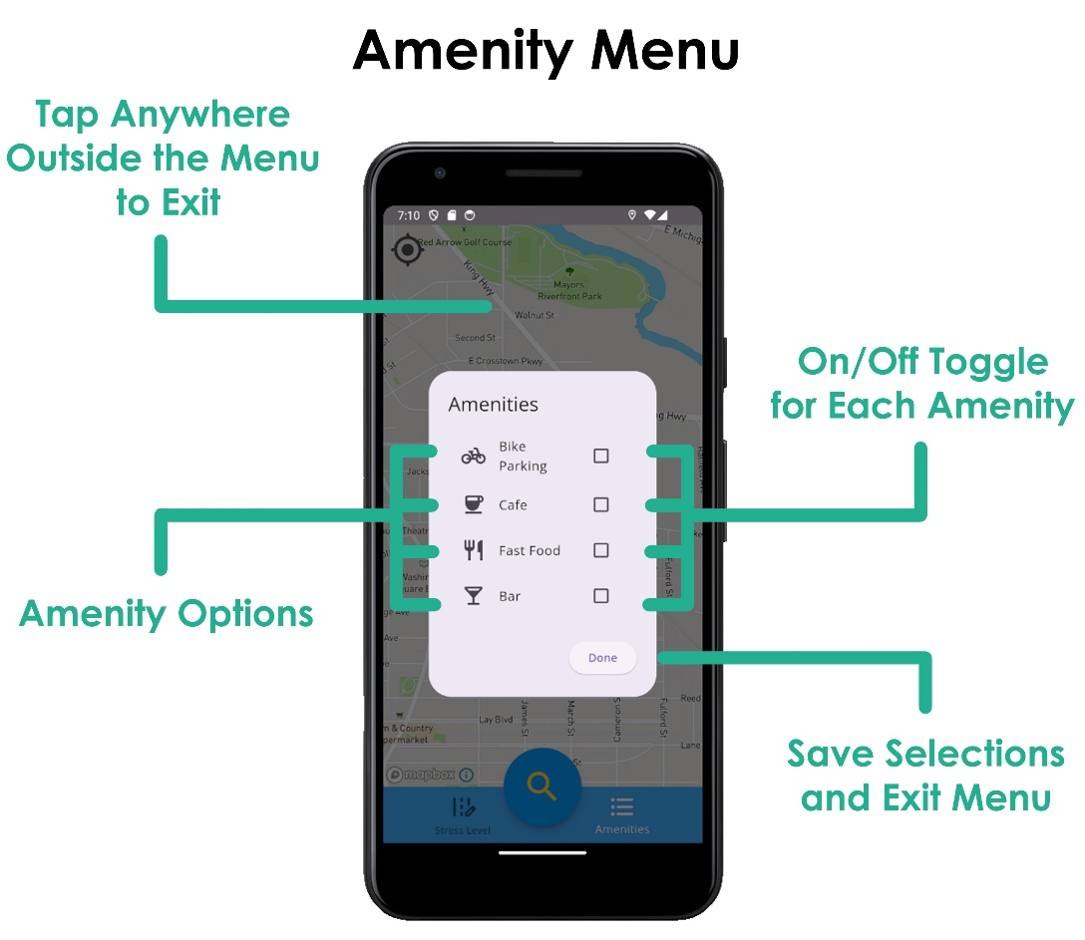
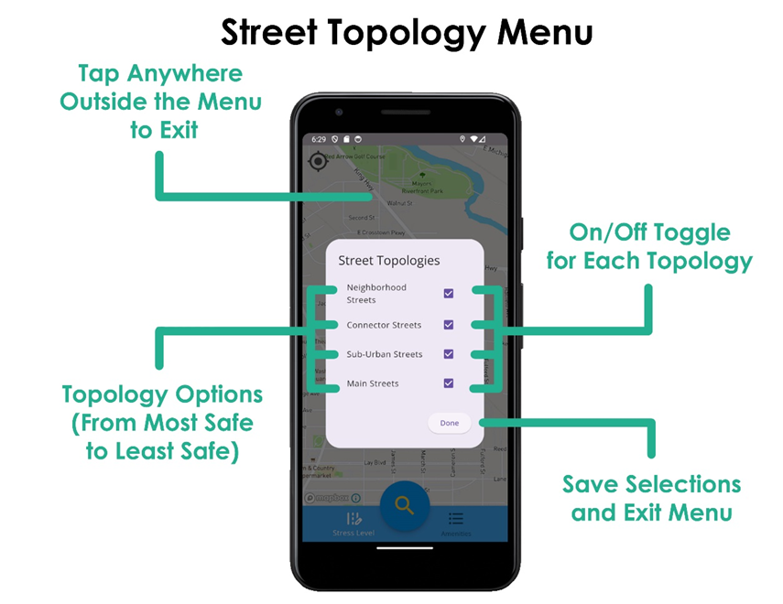
Application Screenshots

Slide 9
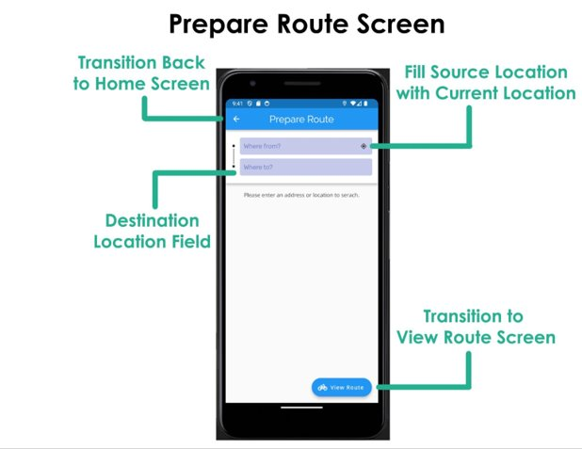
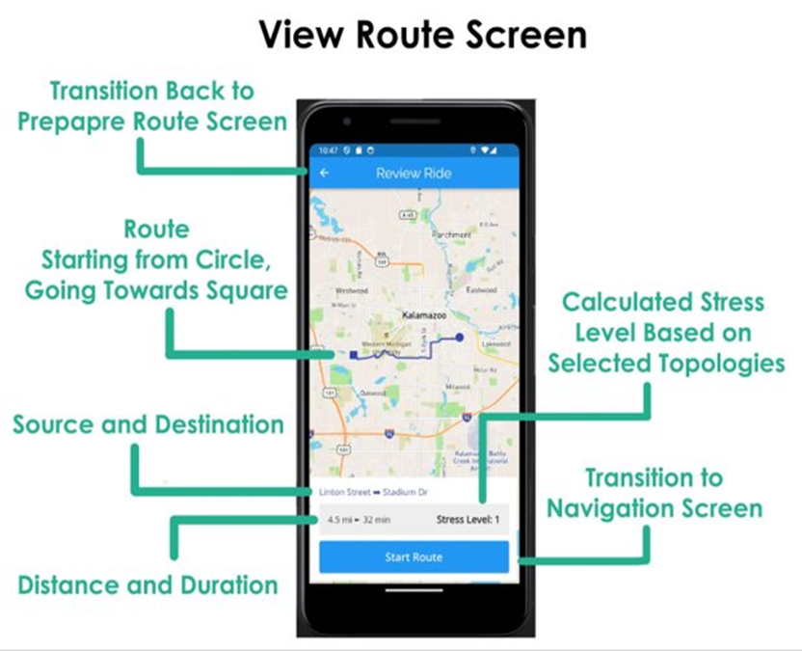
Application Screenshots

Slide 10
Application Screenshots

Slide 11
Development Plan
Flutter:
Used Flutter as the development framework for the app.
Designed and developed user interfaces using Flutter's widgets.
Implemented user profiles for personalized route recommendations.
Integrated database storage using Flutter.
Mapbox:
Integrated Mapbox API for map rendering and navigation.
Utilized MapBox's routing services and algorithms for route calculation.
Displayed the user's location on the map.
Enabled real-time updates for estimated time of arrival (ETA).
GraphHopper:
Utilized GraphHopper for routing and directions.
Considered factors like traffic, road type, and user preferences in route calculation.

Slide 12
Challenges
Discuss the challenges faced during the project.

Slide 13
Improvements
Present the solutions and workarounds for the challenges.

Slide 14

Questions
Thank you. Now, we would be happy to answer any questions or engage in discussions regarding our Bike Routing Application project. Please feel free to ask any questions or share your thoughts.

Slide 15
Thank You

